Slide 1
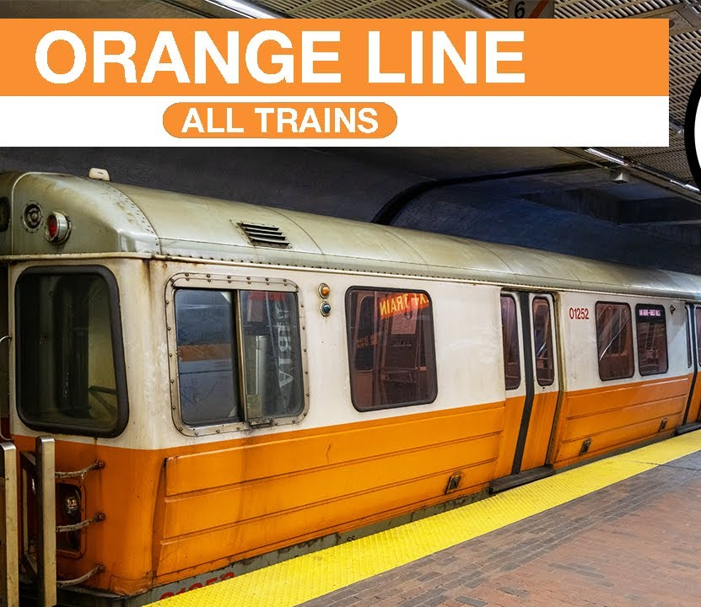

MBTA OPTIMAL SCHEDULE FINDER
CS 5100: Foundations of Artificial Intelligence
CHITTELA AJAYANATH SUJAN DM ASHWIN GURUMURTHY

Slide 2
Motivation
Public transports are extensively used in big American cities, particularly in Boston and its suburbs, for daily commutes.
Riders frequently experience unpredictable waits, standbys, and delays, while the MBTA struggles to add more trolleys.
Our project aims to understand passenger movement using the MBTA and identify patterns and passenger flow at different time and dates of the week.
We aim to propose an optimal schedule for trains through the MBTA orange line, to prevent delays while keeping a higher frequency in busier times to cater to the larger demand.

Slide 3
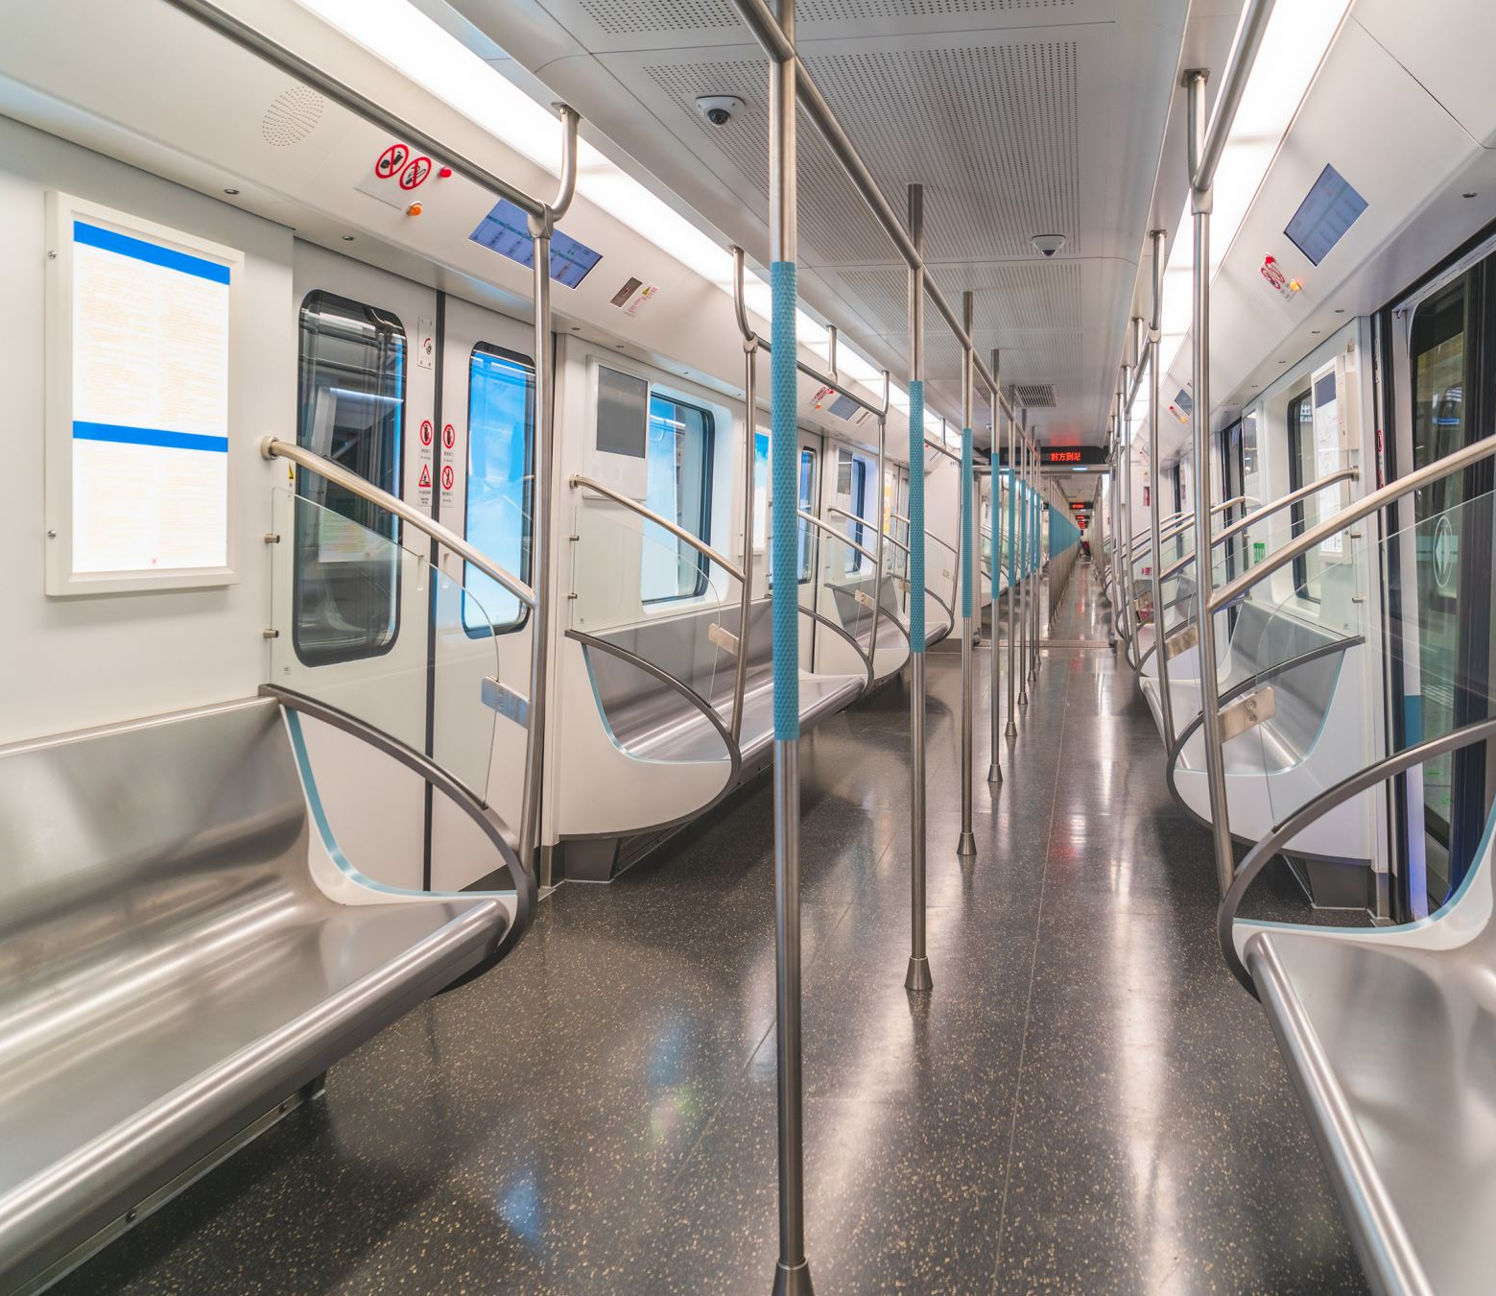
Overview
The system uses local search techniques (Hill Climbing /Simulated Annealing) to optimize train scheduling.
We have analyzed passenger flow data (ons/offs) across different time periods for fall 2019.
GTFS data was used determine available train slots and duration between each stop.
Eventually, we optimized train allocation to minimize passenger wait times and overload.
Interactive Application: Develop a Streamlit web app allowing users to plan trips based on dynamic schedules

Slide 4
Environment And Dependencies
Python 3.11+ including libraries:
pandas
numpy
scikit-learn
matplotlib
seaborn
gtfs-kit
streamlit

Slide 5

Sourcing Of Data
After exploration, GTFS and MassDot MBTA Rail Ridership by Time Period, Season, Route/Line, and Stops were two viable datasets we explored.
The GTFS by the MBTA give us a detailed summary of the MBTA, all of its stops and past scheduling of trains. This is useful to understand current ridership patterns.
The MassDOT MBTA Rail Ridership by Time Period, Season, Route/Line, and Stops, is the heart of our project.
It contains detailed summaries of ridership counts, time taken between stops and breaks down data by time periods: AM Peak, Midday, PM Peak, Evening, and Late Night and for weekdays and weekends.

Slide 6
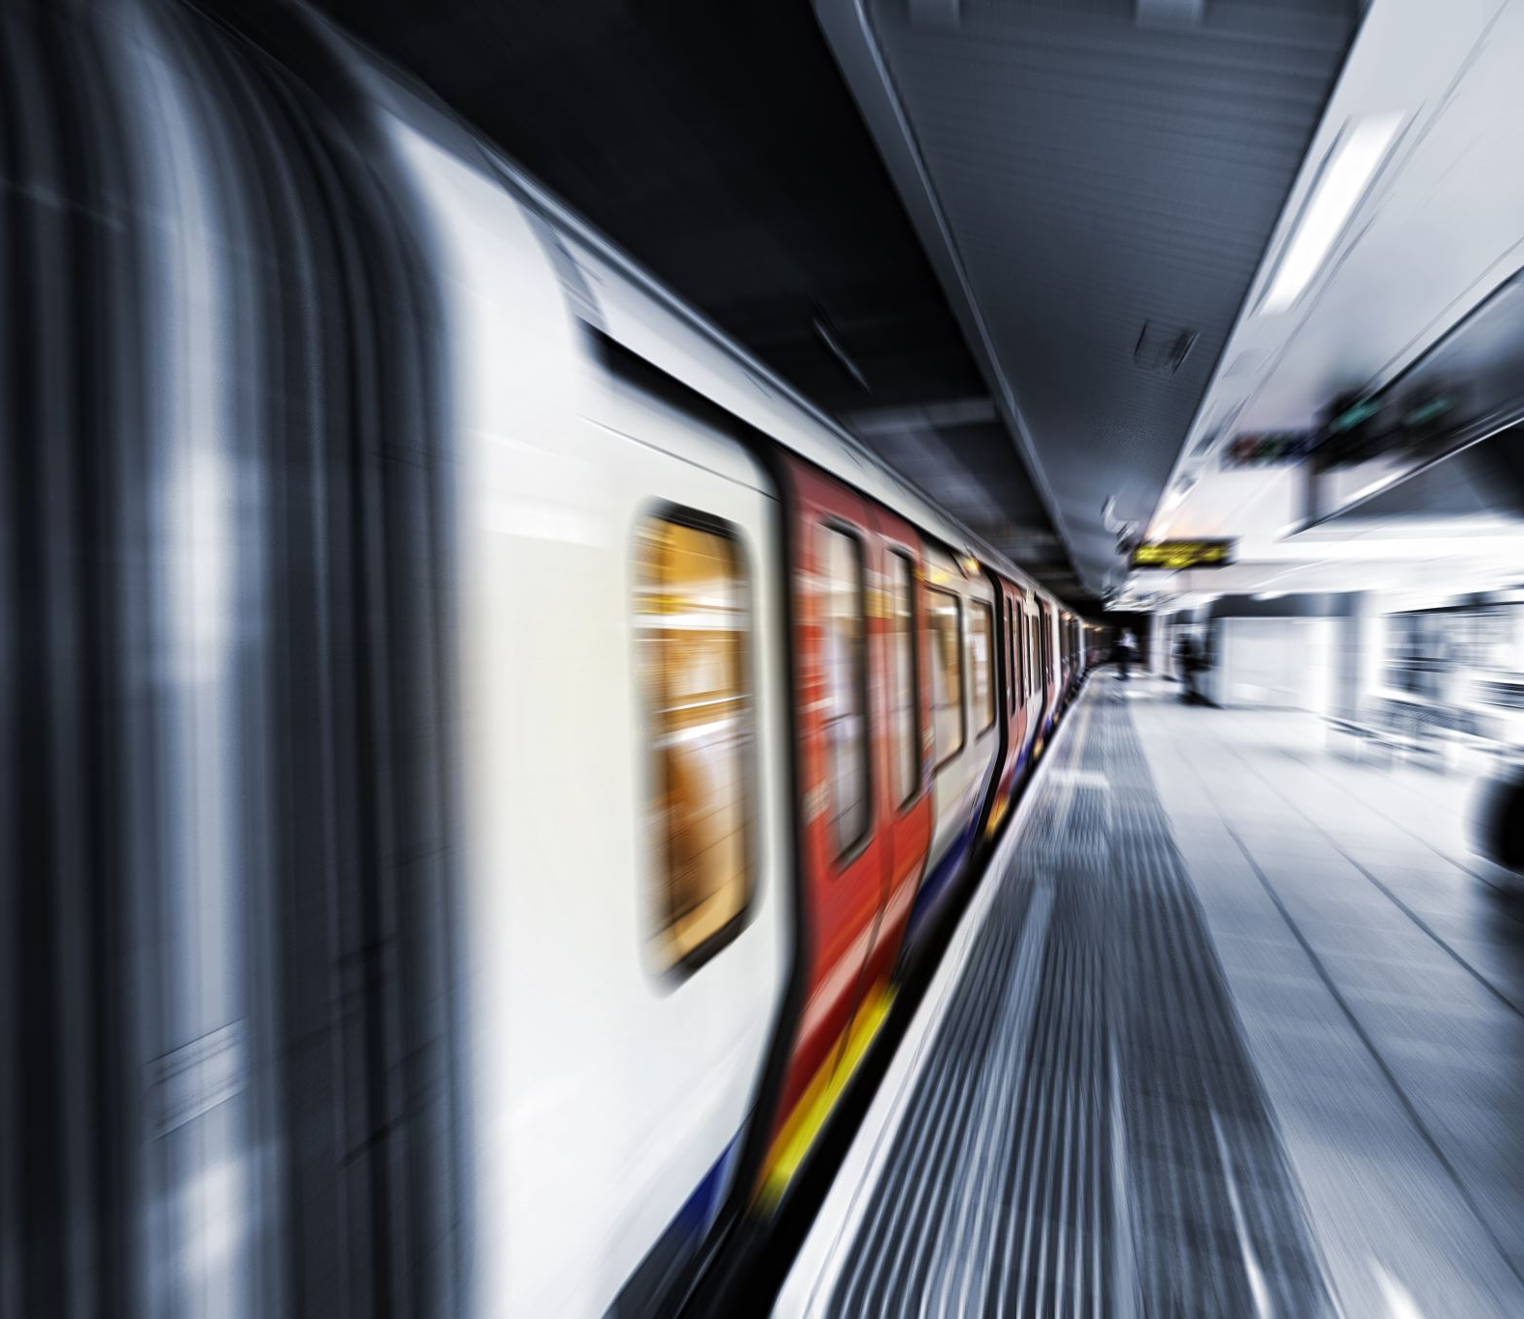
Assumptions
Each train as a capacity of 1000 passengers
We have set a minimum frequency to be 6 minutes and a maximum frequency to be 20 minutes between each train.
Speed of each train is a constant 7.73379 meters per second.

Slide 7

Explore And Preprocess Data
The data for all stops in all lines were given, we chose to filter out only the orange line.
144 hourly time slots (by day type × hour × direction) with max train limits were constructed, based on the 9 defined time periods.
This gives us an idea of the busier and less busier times.
For each of those, total boardings, alightings, and geometric mean demand for each slot were computed to feed the optimizer.
The distance between each stop. With our speed assumption, we were able to compute how much time it would take to reach a particular stop

Slide 8
Design And Approach To Solve The Problem
We broke down this problem to a local search that aims to minimize the cost function we formulated.
To solve this optimization problem, we have used hill climbing and simulated annealing to aim to find the optimal schedule.
Optimal schedules were computed separately for weekdays, Saturdays and Sundays.

Slide 9
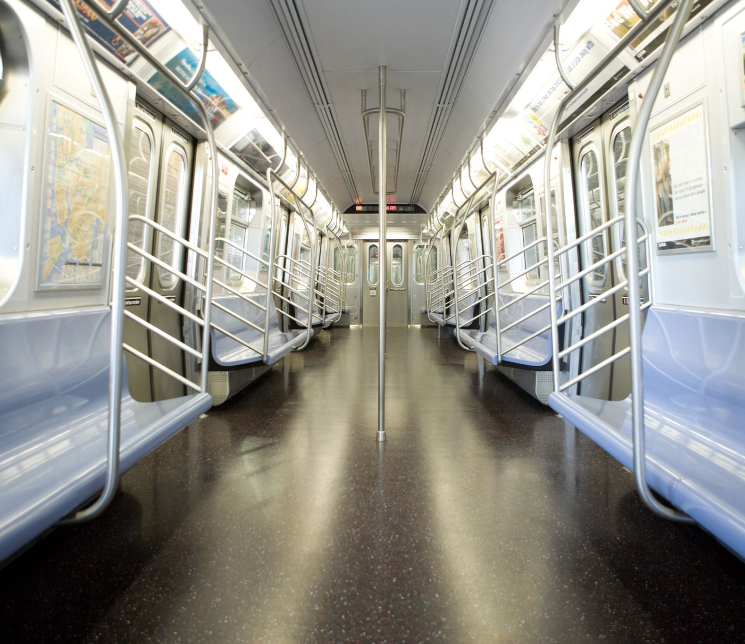
Cost Function
For each (day_type, hour, direction) time slot, the total cost is calculated based on the following penalty components:
Overload Penalty: Applied when the load per train exceeds train capacity (1000 passengers) - This discourages overcrowded trains.
Underutilization Penalty: Applied when trains are running at less than 30% of their capacity (i.e., under 300 passengers per train) - This penalises nearly empty trains to improve operational efficiency.
Wait Time Cost: Proportional to how long passengers must wait based on train frequency - This cost promotes reduced wait times for riders.
Frequency Constraint Cost: Penalty added when frequency constraints are violated (i.e., outside the 15 to 30-minute range) - Encourages maintaining regular and predictable service intervals.
No Train Penalty: Large penalty added if no train is scheduled while demand exists - Adds 100,000,000 to the total cost. Forces minimum service coverage.

Slide 10
Hill Climbing
Pick one random time slot.
Try a small change:
Increase or decrease the number of trains by 1.
Evaluate the new cost.
If the new cost is lower, accept the change.
If the new cost is higher, revert to the previous train count.
We have done this for 1000 iterations.

Slide 11
Simulated Annealing
Simulated Annealing is a probabilistic optimization algorithm inspired by the annealing process in metallurgy, where materials are slowly cooled to reach a low-energy, stable state.
Accept the new solution, if always accept but if accept with some probability: e^{-(new-old)/T}
Temperature is reduced after each step with cooling rate.
temperature = 1000
cooling_rate = 0.995
max_iterations = 1000

Slide 12
Summary Of Our Approach
Successfully generated different schedules for weekday (high frequency), Saturday (moderate), and Sunday (reduced service).
Simulated Annealing achieved lower cost (24.9M) vs Hill Climbing (31.432M).
Created interactive Streamlit app with date-based schedule selection

Slide 13
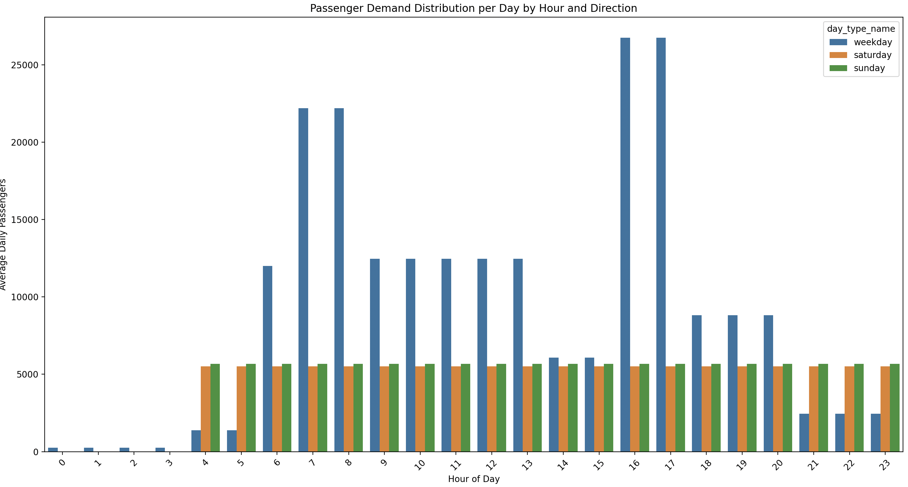
Demand Distribution

Slide 14
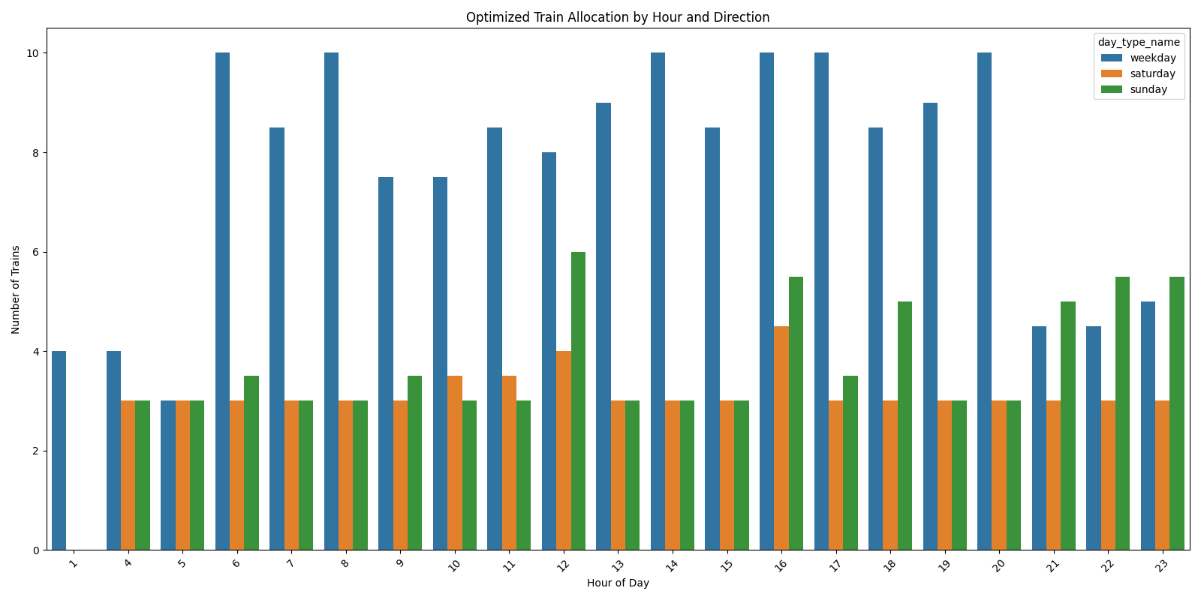
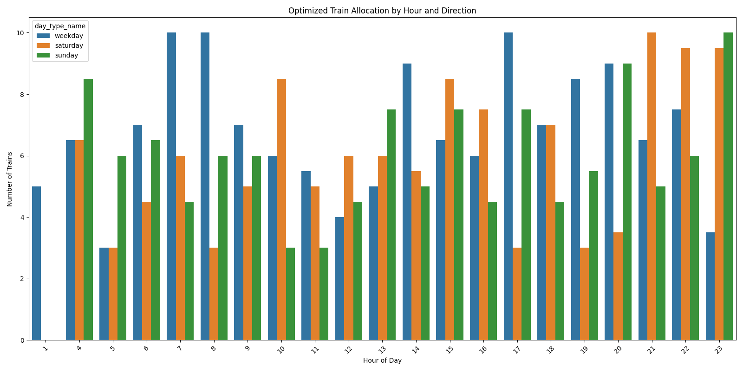
Train Allocation Comparison Hill Climbing vs Simulated Annealing
Simulated Annealing
Hill Climbing

Slide 15
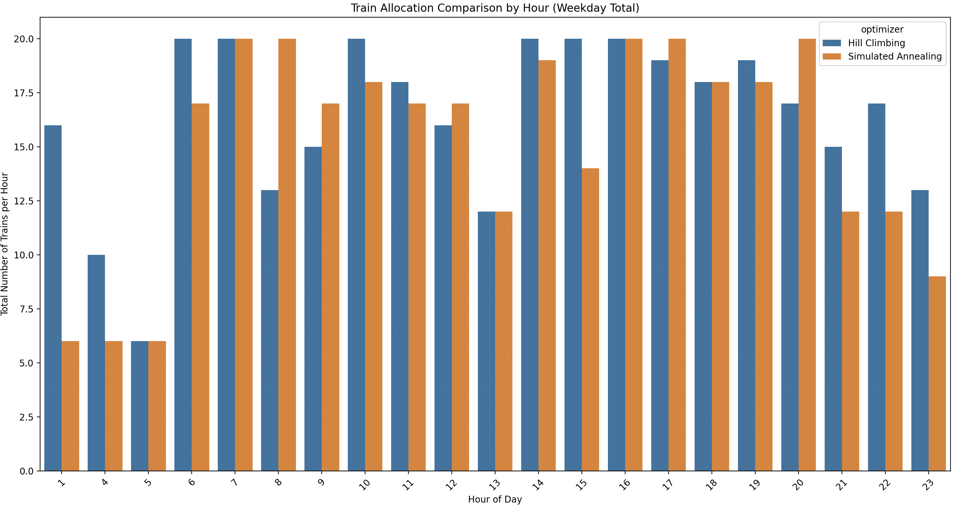
Train Allocation Comparison

Slide 16
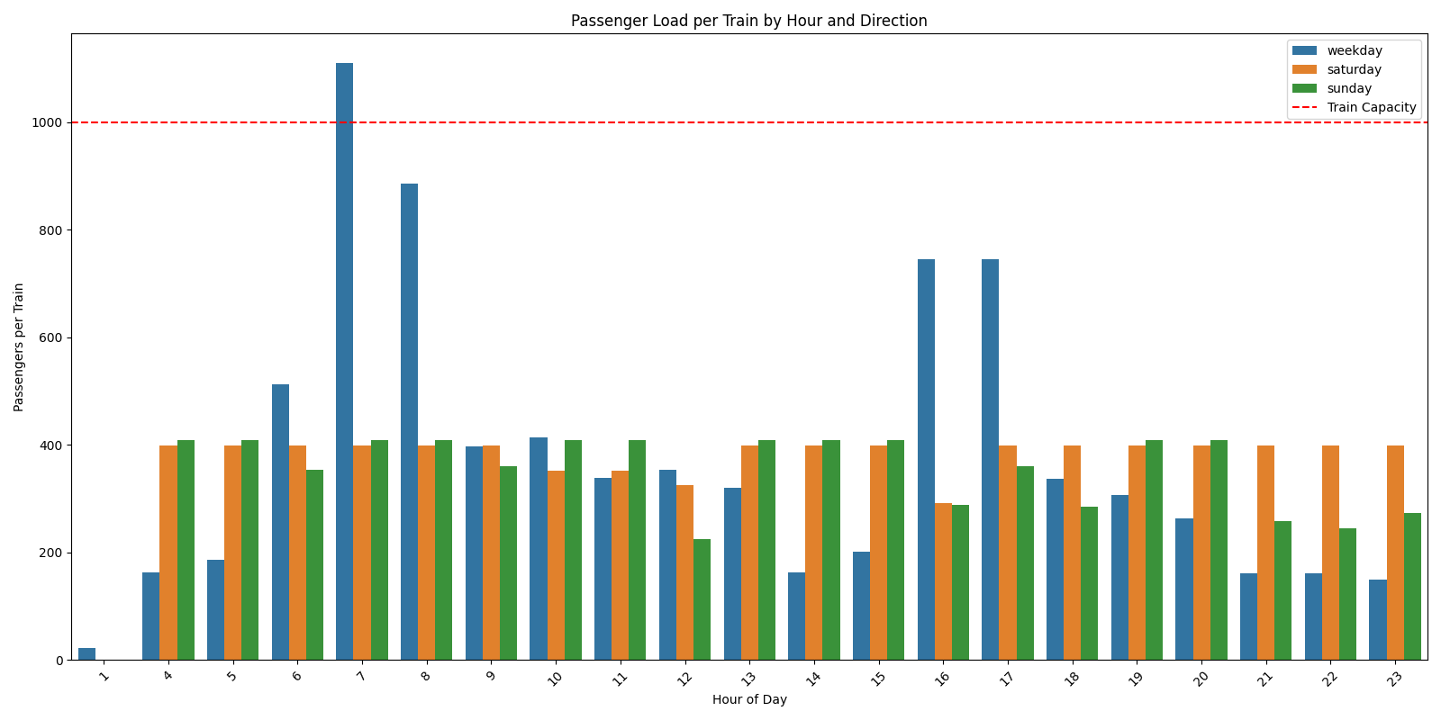
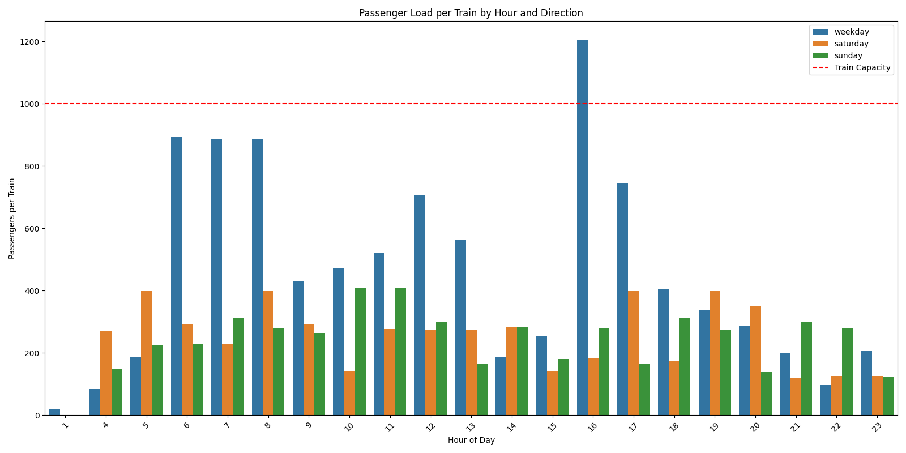
Load Distribution Analysis Simulated Annealing vs Hill Climbing
Simulated Annealing
Hill Climbing

Slide 17
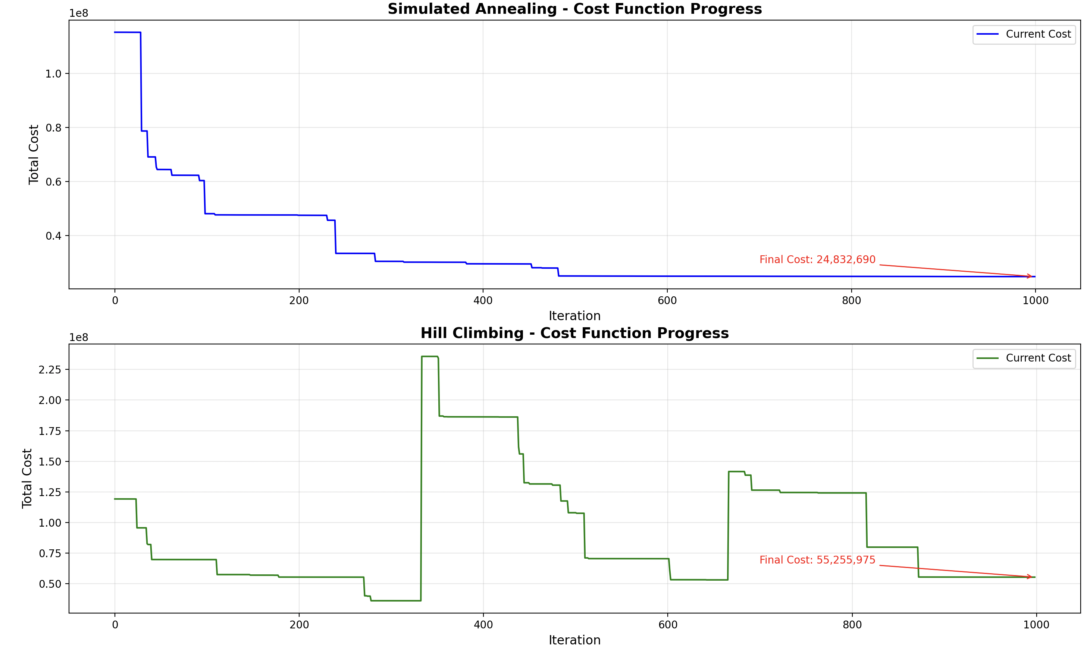
Cost Function Analysis

Slide 18
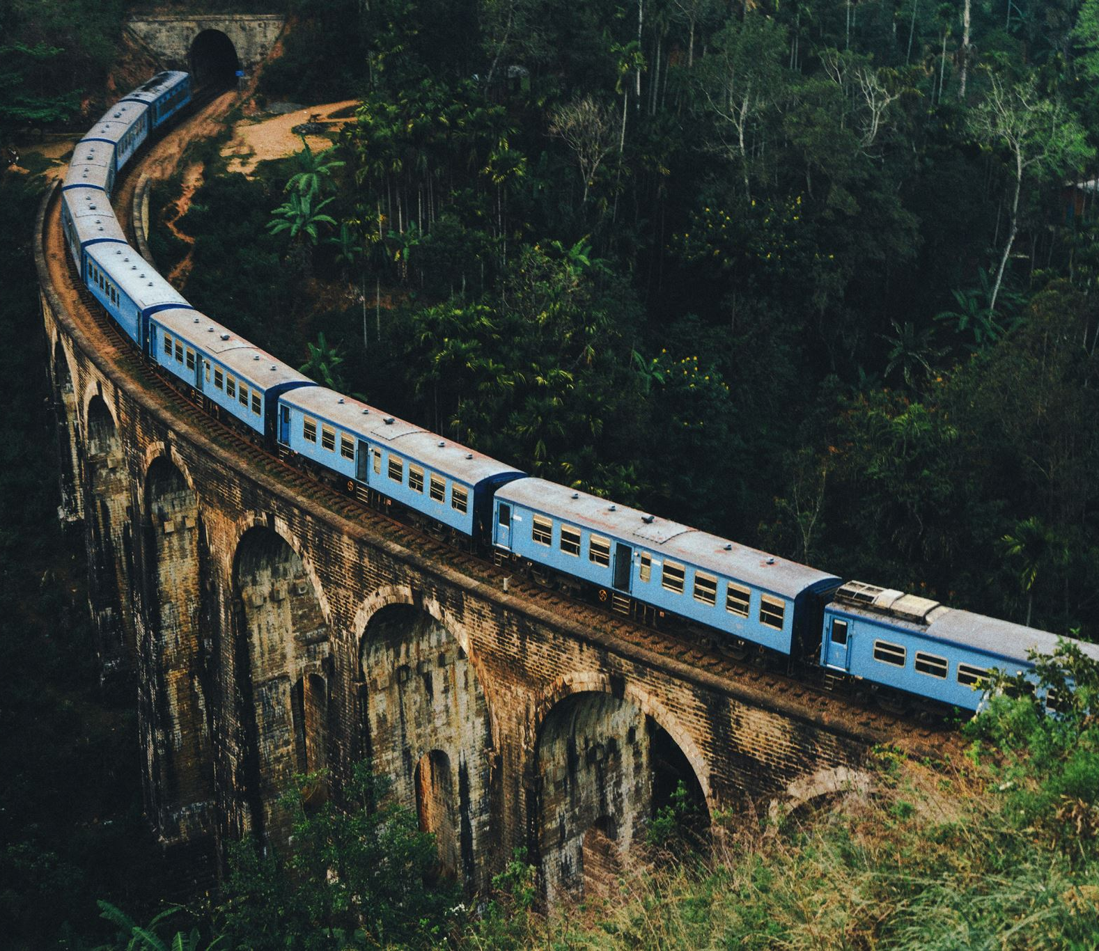
Verdict
Simulated annealing converged at a lower cost
Simulated annealing successfully managed to ensure no train is allotted beyond our 1000 capacity
Simulated annealing managed to better allocate trains and minimize total number of trains, as compared to hill climbing
Clearly, simulated annealing is the superior approach.

Slide 19

Visualizing Output
We developed a streamlit based webapp to show our outputs for the better approach
It allows the user to choose a source and destination stop and the time at which they intend to depart.
The webapp shows the next 5 trains including the departure and arrival times, based on our optimal schedule we computed.

Slide 20
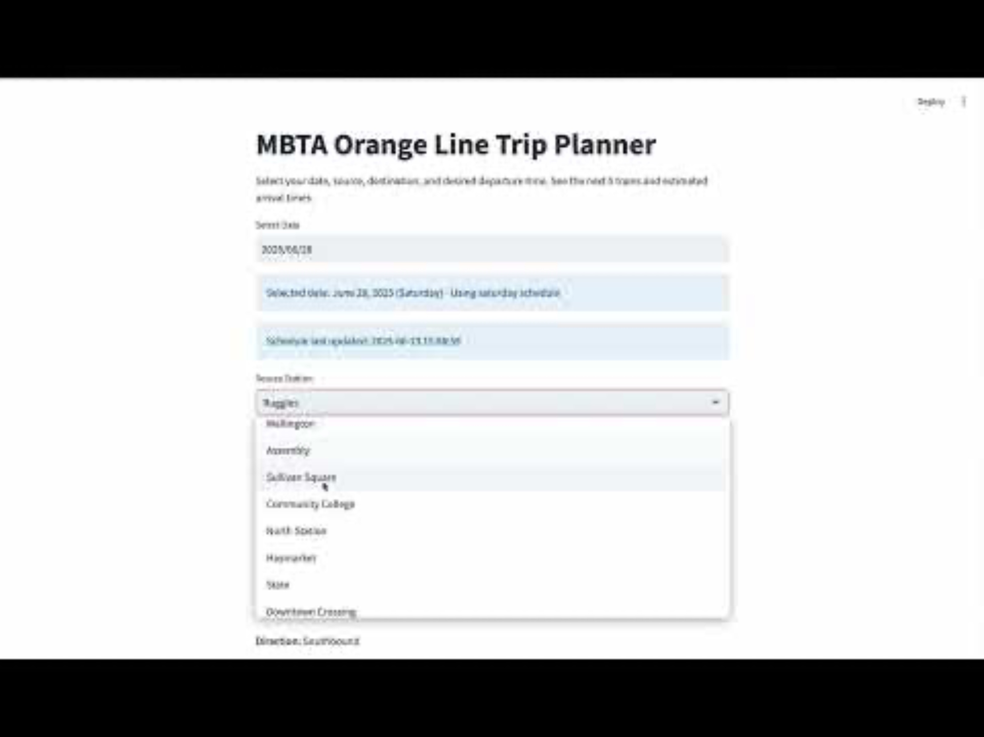
Web App Demonstration

Slide 21
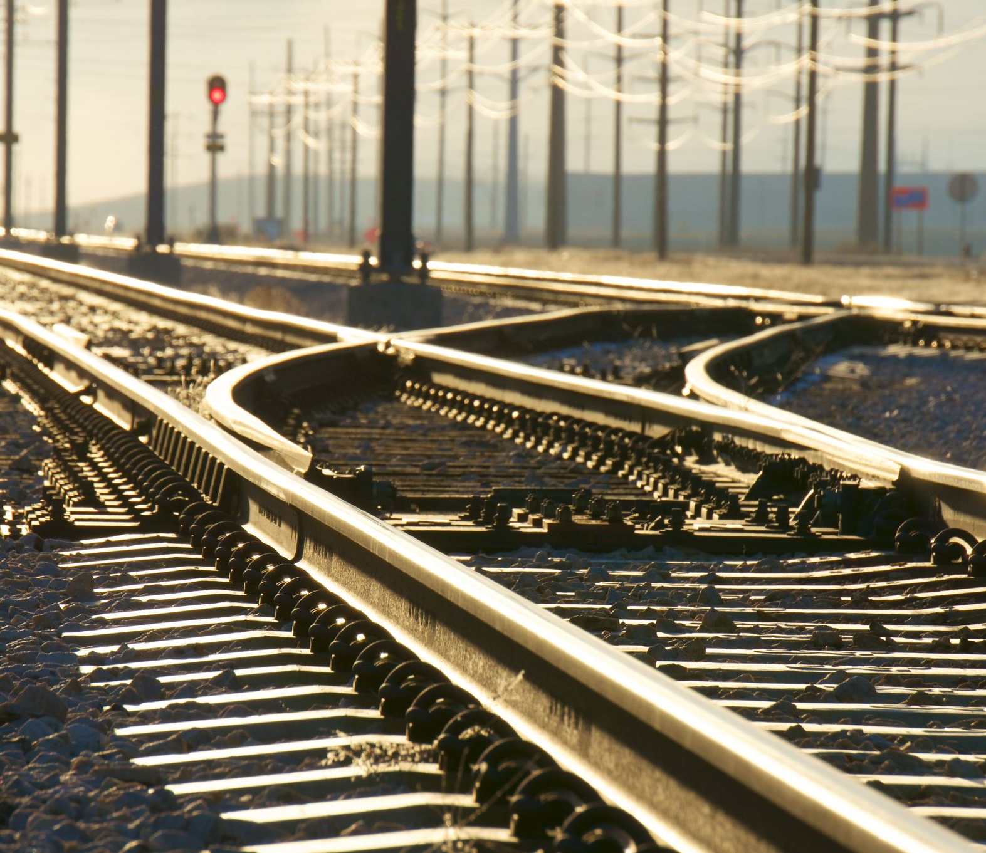
Final Results
Actual use of trains
Weekdays: 320 trains
Saturdays: 260 trains
Sundays: 220 trains
Our optimal schedule utilizes
Weekdays: 320 trains
Saturdays: 127 trains
Sundays: 152 trains

Slide 22
Conclusion And Future Work
We have demonstrated how local search can be used to solve a day-to-day nuisance every commuter experiences.
By integrating the detailed MBTA GTFS schedule data with MassDOT’s granular ridership statistics, this project builds a robust foundation to detect bottlenecks and devise an optimal schedule for trains.
Our project will minimize wait times, balance trolley flow, and enhance overall system efficiency.
Future work includes extending this application to to other lines and modes of transport and making this schedule more real time. More factors can be taken into account such as public holidays and special events(like a red sox game).

Slide 23
THANK YOU
Github:
https://github.com/SujanDM04/MBTA-LATEST.git

